Slide 2
Return to Campus
Florida State University's top priority is the health and safety of the campus community.
Our plan prioritizes the well-being of every member of our community, including students, faculty and staff as well as visitors, volunteers and vendors and strives to create a healthier, safer environment for all. It incorporates new policies, procedures and oversight for teaching, learning and working, including strategies to protect individuals at a higher risk for developing adverse outcomes for COVID-19.
The Fall 2020 Plan can be found here: https://stayhealthy.fsu.edu/sites/g/files/upcbnu2976/files/documents/FSU-Plan-Fall-2020-BOT-Approved.pdf

Slide 3
The Stay Healthy Ambassador Program (SHAP) will commence during the start of the fall 2020 semester and consists of trained volunteers from various FSU departments and organizations.
Responsibilities include:
serving as a source of information to promote the university’s expectations, Stay Healthy FSU, Virtual FSU, and other available services
encouraging face mask/covering usage
encouraging physical distancing
providing directions to hand sanitizer stations or hand washing locations
distributing COVID-19 packets that include face coverings, tissues, hand sanitizer, and water

Slide 4
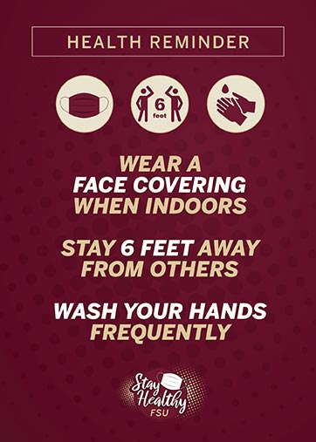
SHAP Recruitment and Training
Recruitment:
Departmental Leaders, Building Managers, Student Organizations
Identify representatives for their area
Submit names through the Qualtrics form on the SHAP website
SHAP expectations:
Hours will vary based on availability of the Ambassadors
The schedule and location of volunteers will be posted on the SHA website
Ambassadors will be identifiable with a shirt and/or button

Slide 5
Resources
https://stayhealthy.fsu.edu/
https://uhs.fsu.edu/coronavirus/testing
https://studentaffairs.fsu.edu/virtualfsu/
https://studentaffairs.fsu.edu/virtualfsu/student-life/
https://coronavirus.hr.fsu.edu/

Slide 6
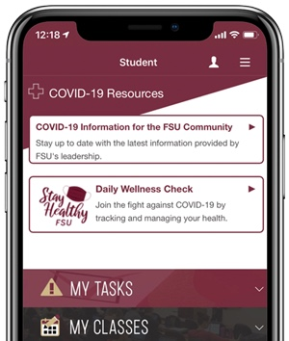
Daily Wellness Check App
Participating in a daily wellness check supports the overall health and wellness of the Florida State community.
All students should complete the Daily Wellness Check Tool in the MyFSU MobileApp or portal each day before coming to campus or leaving their residence hall.
SHAP volunteers will encourage the use of the wellness app.

Slide 7
Goals
Reduce the spread of COVID-19 virus
Create a culture of accountability, health, and safety
Campus-wide outreach within all departments and buildings
Increased accessibility to information and resources
Quick and effective response to COVID-related concerns or issues

