Slide 1



Slide 2
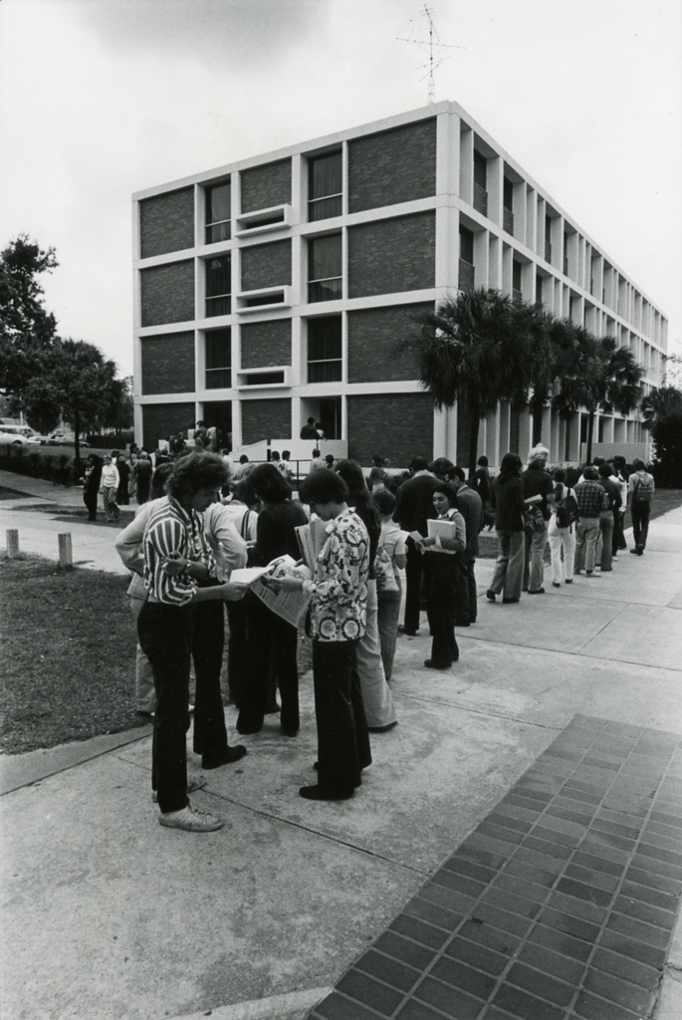

Journey Through Our History
Discover how our institution has evolved from a small seminary into a world-renowned research university, celebrating the people, discoveries, and traditions that define our legacy.
175.fsu.edu
Thagard Building

Slide 3
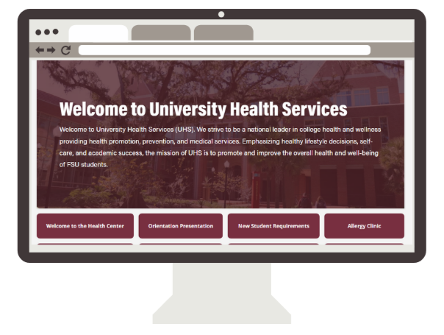
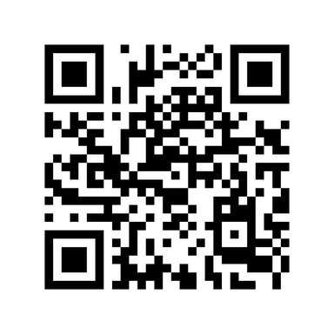


New Student Information &
This Presentation
Scan me

Slide 4


Hours of Operation & Location
  Monday through Friday​
  Appointments available 8:00AM – 4:00PM​
    Appointment-based system
    Appointments can be scheduled online, by phone, or in-person ​
    Staffing available until 5:00PM​​​
  Located at the Mary B. Coburn Health & Wellness Center

Slide 5

Appointments available for:
Mental Health
Physical Therapy
Well and preventative physicals (athletic, band, women’s annual exams
Diagnostic Imaging (x-rays, ultrasounds)
Immunizations
Upper Respiratory Infections
Allergy Injections
Women’s Care (full-service gyn care with the exception of OB care)
Lab Services
Virtual Services that are amenable to telemedicine
Medication Refills
STI Testing
Routine follow-ups and Chronic medical care
Acute illness and injury

Slide 6

Why Choose University Health Services for Your Student’s Care?
  Convenience: Located on campus, easily accessible, saving students time and effort in seeking medical care.
  Specialized Services: We provide services tailored to the specific needs of college students, including mental health support, sexual health education, and stress management.
  Integrated Care: We coordinate with other campus resources, such as academic advisors, food pantry, case management and counseling services, to provide holistic support.
  Familiarity: We specialize in student health and student-specific health issues, creating a more comfortable and understanding environment.

Slide 7
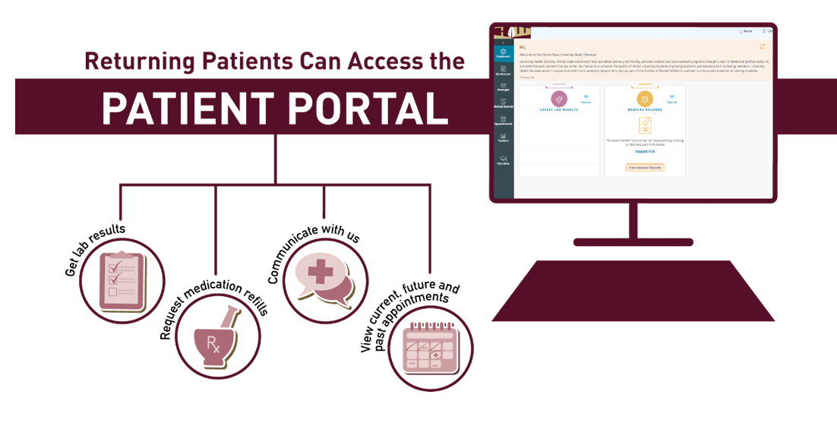

Online Scheduling

Slide 8
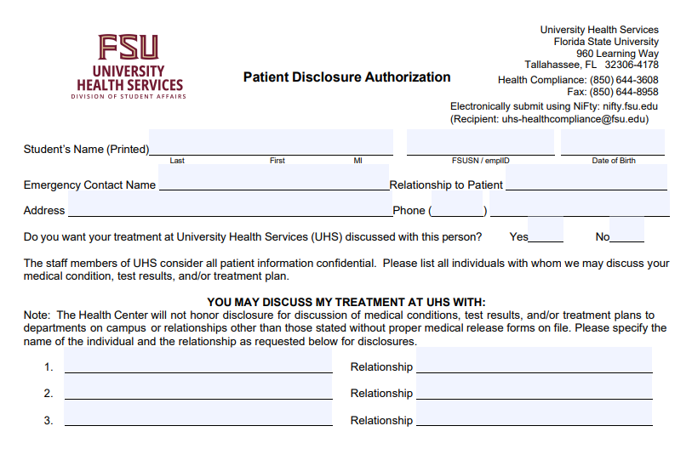
Disclosure of Personal Health Information
  Students will receive this during their first visit
  A signed disclosure form from the student is required before we can speak with anyone else
    Exceptions:​
      Minors under the age of 18​
      Life-threatening emergencies​
  Student may rescind/modify disclosure form at any time​
  Maintain open channel of communication with your student

Slide 9
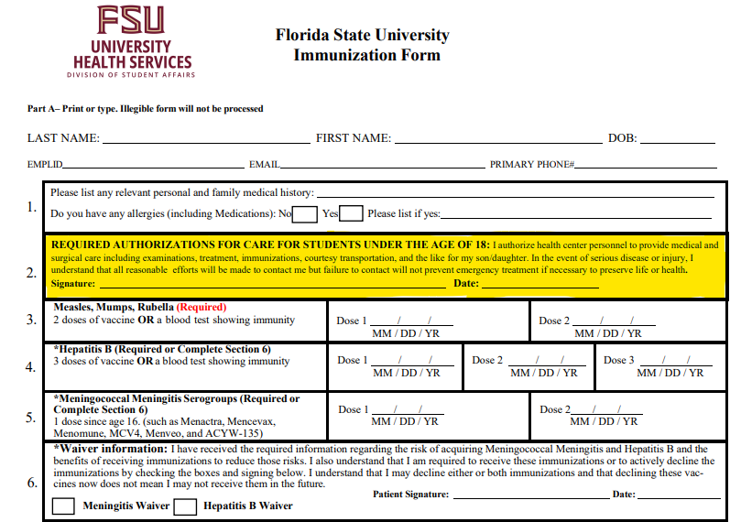
Consent to Treat Minors
  If the student is under 18, a parent/guardian must sign the “Authorization for Care of Students Under Age 18” statement on the FSU Immunization Form

Slide 10
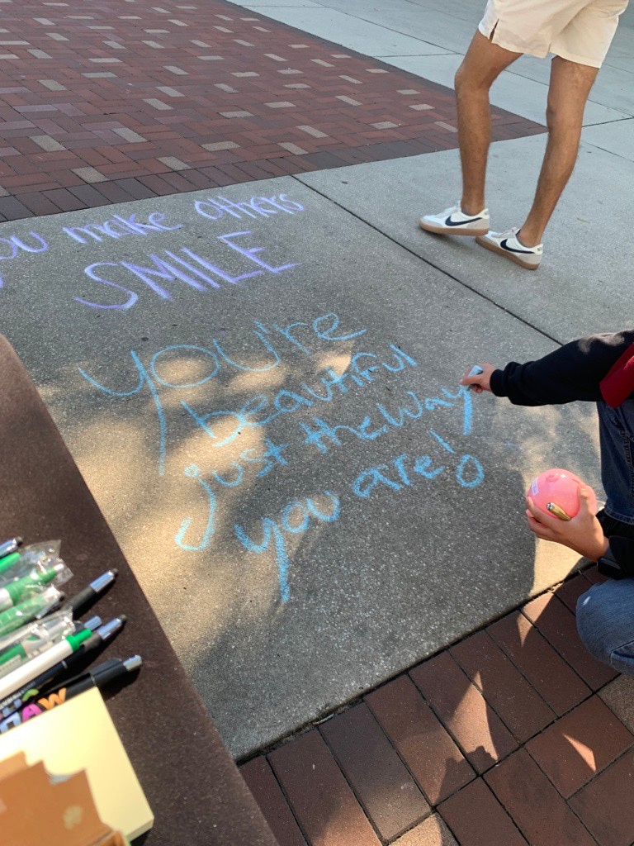


  Nutrition consultations
  HIV testing
  Smart Choices: Alcohol/drug harm reduction program
  Green Dot Bystander Intervention
  Healthy Noles Peer Education
  Power-based personal violence prevention

Slide 11


Other Services available in the
Health & Wellness Center
Morgan Dental and Quest are independent vendors of the university that provide services to the greater FSU community including students, faculty, and staff.
For questions about insurance coverage, please contact the vendor directly.

Slide 12


After-hours System of Care
uhs.fsu.edu/health-care/after-hours-care
Other After-Hours Care Options Include:
Talk to a doctor or therapist by phone or video with HealthiestYou.
HealthiestYou provides 24/7 access to doctors and mental healthcare.
Download the App - iOS - Google Play
Call (855) 870-5858
Walk-in Clinics
Urgent Care
Emergency Room

Slide 13

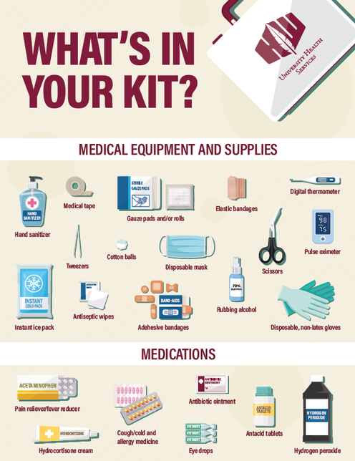

Pharmacy
  No onsite pharmacy​
  CVS located near campus (West Pensacola Street location)​
  Several nearby pharmacy options available​
    https://uhs.fsu.edu/health-care/local-pharmacy-info
  Some pharmacies offer specific reduced cost medications
Bring a “feel better” kit​
  OTC medications
  Band-Aids®
  thermometer​

Slide 14


Insurance & Billing
  The Student Health Fee helps ensure students have access to affordable primary care, emergency response, health education, and campus-wide public health services that keep them healthy and supported throughout their time at Florida State
  We bill insurance for most services; co‑pays are not collected at the visit
  Any remaining balance after insurance is billed to your student account
  We are in-network with many insurance plans. If your plan is out-of-network, charges not covered by your insurance will be posted to your student account.
  Out‑of‑network for AvMed and Tricare Prime
  Health insurance is required; a university plan is available
  Bridge of care options
  Emergency Room care is for true emergencies and is not a substitute for primary or specialty care

Slide 15
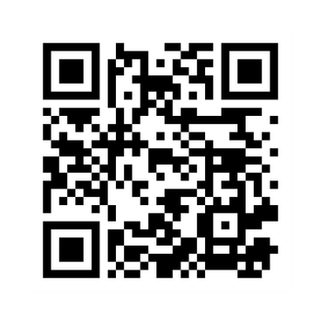

Your Go-To for Insurance & Immunization Information
studentinsurance.fsu.edu

Slide 16


University Health Services Student Insurance Rates 2025/2026
*Current through Summer 2026
​ | Domestic Student​ | International Student​
Annual: Aug. 15 – Aug. 14​ | $3,009 | $3,057
Fall: Aug. 15 – Dec. 31​ | $1,146 | $1,165
Spring/Summer: Jan. 1 – Aug. 14​ | $1,863 | $1,893
*Summer: May 10 – Aug. 14​ | $800 | $812
studentinsurance.fsu.edu

Slide 17

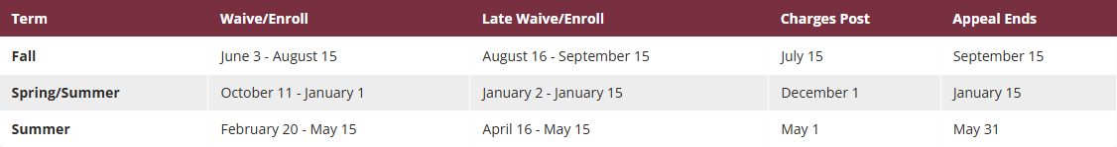
Student Health Insurance: Key Dates & Communications
*This is an annual requirement
*Student-athletes will complete this each semester
Students receive ongoing reminders starting at admission, with increased communication before key enrollment and waiver deadlines sent to their FSU email, as well as through social media and campus newsletters.

Slide 18





Get Involved
UHS offers several ways for students to become involved. ​
To learn more, visit uhs.fsu.edu/getinvolved

Slide 19
Tips for First Year Students
Know Your Insurance Coverage
Understanding your health insurance can help you avoid unexpected costs. Learn more about your coverage by calling the number on the back of your insurance card. Know whether your insurance plan is an HMO or PPO.
Reach Out — Even If You're Not Sure
Not sure where to start? Contact us. We’re happy to help you understand your options and connect you with the care you need.
Bring What You Need
Bring your FSUCard and health insurance card to your appointment.
Know Your Health History
Be familiar with your medical history, allergies, medications, and family health history.
Understand Your Insurance Details
Understand your insurance benefits, including preferred lab providers like Quest or LabCorp.
UHS NPI: 1699809236 | Tax ID: 59-1961248
Practice Healthcare Independence
Learn to schedule appointments, pay copays, and fill prescriptions independently.
Keep Your Appointments
Arrive on time and keep all scheduled appointments. UHS charges a $30 no-show fee for missed appointments.
Take Care of Yourself
Prioritize self-care, healthy eating, and adequate rest.

Slide 20
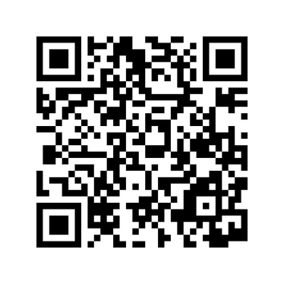
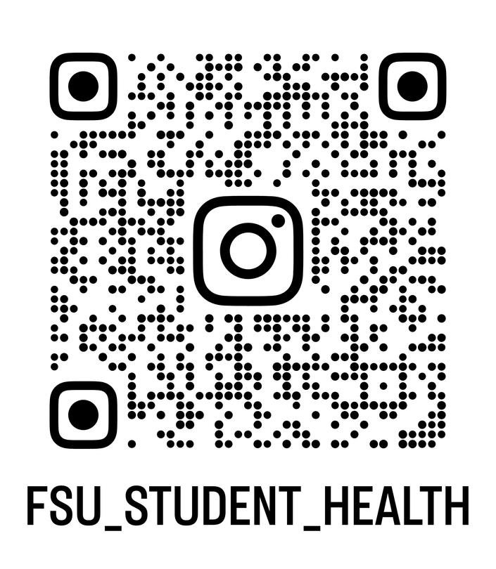







Connect With US
@FSUHealth_Services
uhs.fsu.edu

Slide 21

Contact Us!
Mari Kay Avant
Amy Magnuson, PhD, RD, LD/N
Assistant Director, Public Relations & Appointment Scheduling
Director
amagnuson@fsu.edu
mavant@fsu.edu
Kelly Dykes, BSN, RN, CHPE, CPHIMS
Corey Williams, BSN, RN, PMH-BC
Associate Director, Student Services, Contracts & Insurance Billing
Mental Health Nurse Navigator
Referral Department Supervisor
kdykes@fsu.edu
cwilliams5@fsu.edu
Latricia Simmons, BSN, RN
Assistant Director, Health Services
lsimmons@fsu.edu

